Slide 1

Assessment Role of the Chairs

Slide 2

Chairs are responsible for:
Make sure the learning outcomes listed for the majors and master’s on the AUP programs website are correct.
Remind your faculty to make sure the learning outcomes listed for their courses on the online catalog are correct.
Make sure the program-course alignments on sharepoint are correct.
Encourage your faculty to use the GOAT to turn in their results.

Slide 3
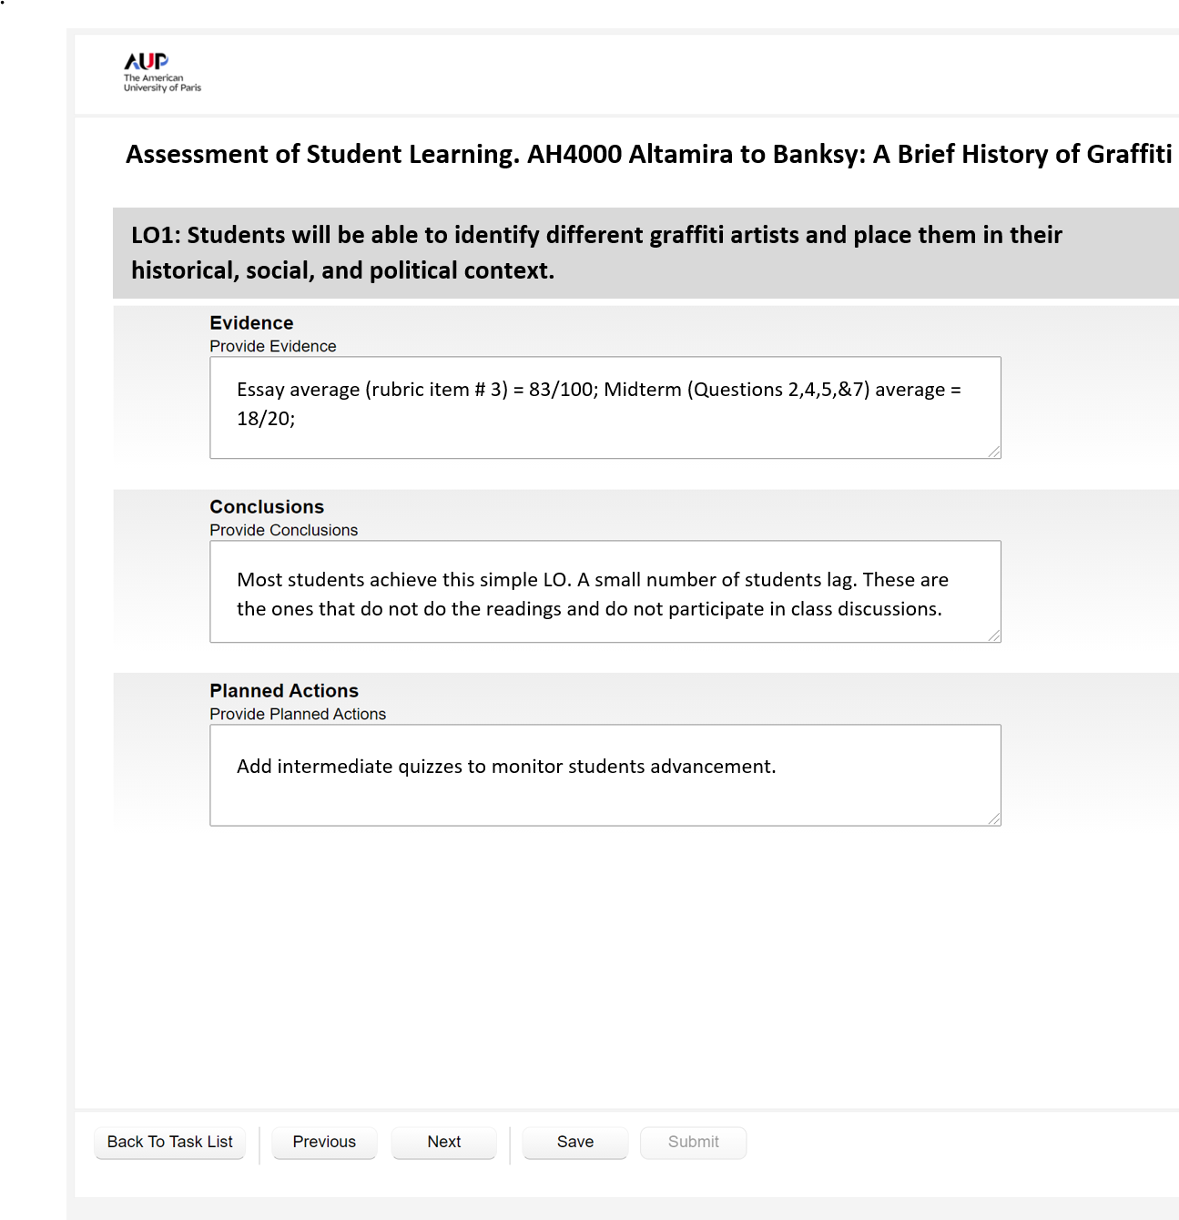
GOAT (Great Online Assessment Tool)
3

Slide 4
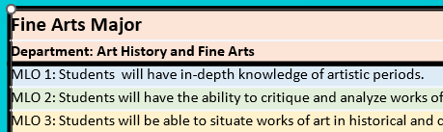
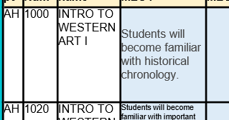
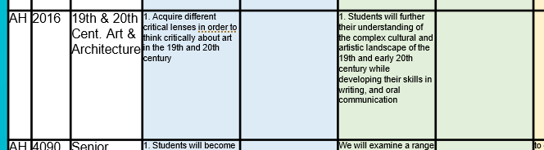
Example of major alignment table (Art History)
Fine Arts Major |  |  |  |  |  |  |  |  |  |  |  |  |  |  |  |  |  |  |  |  | Number of courses that feed into the LO
Department: Art History and Fine Arts
MLO 1: Students will have in-depth knowledge of artistic periods. |  |  |  |  |  |  |  |  |  |  |  |  |  |  |  |  |  |  |  |  | 3
MLO 2: Students will have the ability to critique and analyze works of art in fluid English prose. |  |  |  |  |  |  |  |  |  |  |  |  |  |  |  |  |  |  |  |  | 3
MLO 3: Students will be able to situate works of art in historical and cultural contexts. |  |  |  |  |  |  |  |  |  |  |  |  |  |  |  |  |  |  |  |  | 6
MLO 4: Students will have the ability to identify artists, styles, time-periods of works. |  |  |  |  |  |  |  |  |  |  |  |  |  |  |  |  |  |  |  |  | 7
MLO5: Students will be able to communicate orally and in writing about a variety of styles and genres. |  |  |  |  |  |  |  |  |  |  |  |  |  |  |  |  |  |  |  |  | 7
Main table
Dept | Crs Num | Course name | Aligned with MLO1 | Aligned with MLO1 | Aligned with MLO2 | Aligned with MLO2 | Aligned with MLO3 | Aligned with MLO3 | Aligned with MLO4 | Aligned with MLO4 | Aligned with MLO5 | Aligned with MLO5 |  |  |  |  |  |  | Comments | Feeds as core to other majors | Faculty and chair initials (signature)
AH | 1000 | INTRO TO WESTERN ART I | Students will become familiar with historical chronology. |  |  |  |  |  | Students will be able to identify major monuments of pre-modern art.. |  | Students will develop visual analysis and concise writing skills. |  | 1. Local and Global Perspectives: Students will enhance their intercultural understanding of languages, cultures, and histories of local societies and the global issues to which these relate (CCI LO1). | 1. Aesthetic Inquiry and Creative Expression: Students will engage with artistic or creative objects (e.g., visual art, theatrical works, film) in different media and from a range of cultural traditions (CCI LO2) |  |  |  |  |  | Art History
AH | 1020 | INTRO TO WESTERN ART II | Students will become familiar with important artistic and cultural trends in the periods covered by the course |  | 1. Students will hone their visual abilities through the careful examination of selected monuments and artists from a broad range of Western history, while developing their writing and verbal skills in analyzing artworks. |  |  |  | 1. Students will acquire the capacity to identify major works of art and to articulate their meaning in relation to their context of production and reception. |  | 1. Students will be expected to engage, orally and in writing, with the ways in which these objects have been interpreted and discussed both historically and in contemporary art historical literature. |  | 1. Local and Global Perspectives: Students will enhance their intercultural understanding of languages, cultures, and histories of local societies and the global issues to which these relate (CCI LO1) | 1. Aesthetic Inquiry and Creative Expression: Students will engage with artistic or creative objects (e.g., visual art, theatrical works, film) in different media and from a range of cultural traditions (CCI LO2) | 1. Exploring and Engaging Difference: Students will think critically about cultural and social difference; they will identify and understand power structures that determine hierarchies and inequalities that can relate to race, ethnicity, gender, nationhood, religion, or class (CCI LO3) |  |  |  |  | Art History
AR | 1020 | MATERIALS AND TECHNIQUES OF THE OLD MASTERS | Know what the traditional materials used for the two dimensional arts are, where those materials come from, and how they are correctly made and used |  |  |  |  |  | tudents should be able to better identify the specific techniques employed by artists and understand why one technique would be favoured over another |  |  |  | 1. Local and Global Perspectives: Students will enhance their intercultural understanding of languages, cultures, and histories of local societies and the global issues to which these relate (CCI LO1) | 1. Aesthetic Inquiry and Creative Expression: Students will engage with artistic or creative objects (e.g., visual art, theatrical works, film) in different media and from a range of cultural traditions (CCI LO2)
AH | 2011 | Ancient Art & Architecture | 1. Deeper understanding of Ancient mythology and cultures. |  | 1. Enrichment of art historical/architectural terminology. | 1. Improved visual analysis and research skills. |  |  | 1. Recognition of major monuments and styles of Ancient art and architecture. |  |  |  | 1. Local and Global Perspectives: Students will enhance their intercultural understanding of languages, cultures, and histories of local societies and the global issues to which these relate (CCI LO1) | 1. Aesthetic Inquiry and Creative Expression: Students will engage with artistic or creative objects (e.g., visual art, theatrical works, film) in different media and from a range of cultural traditions (CCI LO2)
AH | 2012 | Medieval Art & Architecture | 1. Students will develop a deeper understanding of Biblical narratives and iconography. |  | 1. Students will enrich their knowledge of art historical/architectural terminology. | 1. Students will improve their visual analysis and research skills. |  |  | 1. Students will be able to recognize major monuments and styles of medieval art and architecture. |  |  |  | 1. Local and Global Perspectives: Students will enhance their intercultural understanding of languages, cultures, and histories of local societies and the global issues to which these relate (CCI LO1) | 1. Aesthetic Inquiry and Creative Expression: Students will engage with artistic or creative objects (e.g., visual art, theatrical works, film) in different media and from a range of cultural traditions (CCI LO2)
AH | 2013 | Renaissance Art & Architecture | 1. Students will become familiar with important artistic and cultural trends of the period. |  | Close visual observation will inform written formal analysis |  | to equip students with the skills necessary to formulate complex theses that address both formal artistic concerns and historical circumstances. |  | 1. We will examine a range of primary sources, both visual and textual, and learn to understand the different ways in which these sources communicated through style, language, and structure. |  |  |  | 1. Local and Global Perspectives: Students will enhance their intercultural understanding of languages, cultures, and histories of local societies and the global issues to which these relate (CCI LO1) | 1. Aesthetic Inquiry and Creative Expression: Students will engage with artistic or creative objects (e.g., visual art, theatrical works, film) in different media and from a range of cultural traditions (CCI LO2) |  |  | students will engage with secondary texts in art history in order to refine their critical evaluation of such scholarship and gain an awareness of the methodologies of the field.
AH | 2014 | Baroque & Rococo Art & Architecture |  |  | 1. Be able to interpret the meaning of works of art based on their visual properties and original contexts. |  |  |  | 1. Learn to identify major works and the philosophical, religious, and cultural contexts that produced them. |  | 1. Develop one’s skills in art historical inquiry, writing, and critical thinking. |  | 1. Local and Global Perspectives: Students will enhance their intercultural understanding of languages, cultures, and histories of local societies and the global issues to which these relate (CCI LO1) | 1. Aesthetic Inquiry and Creative Expression: Students will engage with artistic or creative objects (e.g., visual art, theatrical works, film) in different media and from a range of cultural traditions (CCI LO2)
AH | 2016 | 19th & 20th Cent. Art & Architecture | 1. Acquire different critical lenses in order to think critically about art in the 19th and 20th century |  | 1. Students will further their understanding of the complex cultural and artistic landscape of the 19th and early 20th century while developing their skills in writing, and oral communication |  |  |  |  |  | 1. Students will demonstrate research and writing skills specific to the discipline, oral communication |  | 1. Local and Global Perspectives: Students will enhance their intercultural understanding of languages, cultures, and histories of local societies and the global issues to which these relate (CCI LO1) | 1. Aesthetic Inquiry and Creative Expression: Students will engage with artistic or creative objects (e.g., visual art, theatrical works, film) in different media and from a range of cultural traditions (CCI LO2) |  |  | 1. Discuss the theory of a correspondence between visual art and music, the philosophy of the sublime, the influence of theosophy, the pressure of a competition between art and industry, the ambition of the avant-garde to reform society through art.
AH | 4090 | Senior Seminar | 1. Students will become familiar with important artistic and cultural trends of the period |  | We will examine a range of primary sources, both visual and textual, and learn to understand the different ways in which these sources communicated through style, language, and structure. Close visual observation will inform written formal analysis |  | to equip students with the skills necessary to formulate complex theses that address both formal artistic concerns and historical circumstances |  | 1. We will examine a range of primary sources, both visual and textual, and learn to understand the different ways in which these sources communicated through style, language, and structure. Close visual observation will inform written formal analysis |  |  |  | 1. Students will apply knowledge and skills acquired through both the core curriculum and their major requirements to a disciplinary or interdisciplinary, cumulative, or project-based experience to express their growth and the totality of their learning while at AUP (CCC LO1) | 1. Students will engage in the self-assessment, reflection and analysis of this process that prepares them for future success and be able to articulate this to future educational and professional interlocutors (CCC LO2) |  |  | students will engage with secondary texts in art history in order to refine their critical evaluation of such scholarship and gain an awareness of the methodologies of the field

Slide 5
If all of the above are done, the assessment of your programs is automated and looks like this:
Art History
Major Learning Outcomes | Missing Assessment | Course Learning Outcome | Evidence | Conclusions | Planned Actions
MLO 1: In-depth knowledge of artistic periods | AH3090 FA22; AH2013 FA22 | AH1003B FA22 LO1: Ability to describe and analyze works of art and to identify their style-periods and cultures. | Formal analysis written assignment: minimum grade 85 (B), maximum, 95 (A), average 91 (A-) Midterm, which included image identification and discussion of style and cultural context: minimum 72 (C-), maximum, 98 (A+), average 91 (A-); most students (11 out of 15) scored between A- and A on this assignment Final exam, which included image identification and discussion of style and cultural context: minimum 86 (B), maximum, 96 (A); most students (13 out of 15) scored between A- and A on this assignment | On average students performed well (between A- and A+) on all assignments that tested their ability identify, describe, and analyze works of art and discuss artistic styles and periods. | No additional action needed
 |  | AH1003E FA22 LO1: Ability to describe and analyze works of art and to identify their style-periods and cultures. | Formal analysis written assignment: minimum grade 80 (B-), maximum, 96 (A), average 92 (A-) Midterm, which included image identification and discussion of style and cultural context: minimum 65 (D), maximum, 100 (A+), most students (10 out of 16) scored between A- and A+ on this assignment Final exam, which included image identification and discussion of style and cultural context: minimum 84 (B), maximum, 100 (A+); most students (14 out of 16) scored between A- and A+ on this assignment | On average, students performed well (between A- and A+) on all assignments that tested their ability to identify, describe, and analyze works of art and discuss artistic styles and periods. As a group, students also showed an important improvement between the midterm and the final exam. | No additional action needed.
 |  | AH1003F FA22 LO1: Ability to describe and analyze works of art and to identify their style-periods and cultures. | Formal analysis written assignment: minimum grade 70 (C-), maximum, 97 (A), average 88 (B+) and most students (10 out of 16) scoring between 90 and 97 (A- to A) Midterm, which included image identification and discussion of style and cultural context: minimum 47 (F; 1 student), maximum 100 (A+), most students (8 out of 16) scored between A- and A+ on this assignment Final exam, which included image identification and discussion of style and cultural context: minimum 84 (B), maximum, 98 (A+); most students (13 out of 16) scored between A- and A+ on this assignment | On average students performed well (between A- and A+) on all assignments that tested their ability identify, describe, and analyze works of art and discuss artistic styles and periods. The group also showed a significant improvement in their performance between the midterm and the final exam.
MLO 2: Critique and analyze works of art in fluid English prose | AH3090 FA22; AH2013 FA22 | AH2000 FA22 LO7: Working knowledge of architectural terminology. | 2 in-class exams, 2 papers | 65% of students achieved this Learning Outcome | I ask a lot of terms on the exams, and expect students to use them in their papers. Perhaps I could make it clearer that it is very important to incorporate the terms in their papers.
MLO 3: Situate works of art in historical / cultural contexts | AH3090 FA22; AH2013 FA22 | AR1020 FA22 LO1: Know what the traditional materials used for the two- dimensional arts are, where those materials come from, and how they are correctly made and used | Individual research and presentation to the class about a color in a work of art. Work of reconstruction of the color. Written exam (multiple answers). | The work of reconstitution is very challenging for undergraduates but they complete their experiment, for most of them. The results of the written exam are more mixed. | Give more practice during the class.
MLO 4: Ability to identify artists, styles, time-periods of works | AH3090 FA22; AH2013 FA22 | AR1020 FA22 LO2: Students should be able to better identify the specific techniques employed by artists and understand why one technique would be favored over another | Research and presentation. Reading of painting treatises. | This work of research seems to be effective in deepening their knowledge of a specific technique or material. | none
 |  | AH2000 FA22 LO2: Ability to identify key architectural monuments and sites of Paris. | 2 in-class exams, on-site visits | 58% of students achieved this Learning Outcome | Usually it is quite straightforward - perhaps we need to make sure that all students go on the visits, so it reinforces what they see
MLO5: Communicate orally and in writing about a variety of styles and genres | AH3090 FA22

Slide 6
ROADMAP to assessmnet
December: remind your faculty to use the Online Assessmnet Tool (GOAT).
May: Department report is due.
March: Facuty Activity Reports are due.
1
3
5
2
4
6
January: GOAT deadline.
April: faculty Interviews.
Sollicit missing assessment results.
Have you implemented last years planned actions?
June: The Dean of IRAE comes after you for your late report. ☺

Slide 7
End

